Slide 1
A Mid level Seminar on Design and Implementation of Asynchronous FIFO using Verilog HDL
Presented by
Y.M Bhavani (11881A0408)
Sowmya Budiga (11881A0445)
Navya Vujini (11881A0427)
K. Bharath (11881A0406)
Under the guidance of
Mr. B. Srikanth
Assistant Professor
Department of Electronics and Communication Engineering
VARDHAMAN COLLEGE OF ENGINEERING

Slide 2
Contents
Introduction
Block Diagram
Design of Asynchronous FIFO
Dual-port RAM
State logic module
Gray code counter
FIFO depth calculation
Conclusion
References

Slide 3
Introduction
An Asynchronous FIFO Design refers to a FIFO Design where in the data values are written to the FIFO memory from one clock domain and the data values are read from a different clock domain.
They are widely used to safely pass the data from one clock domain to another clock domain
The two clock domains are Asynchronous to each other.

Slide 4
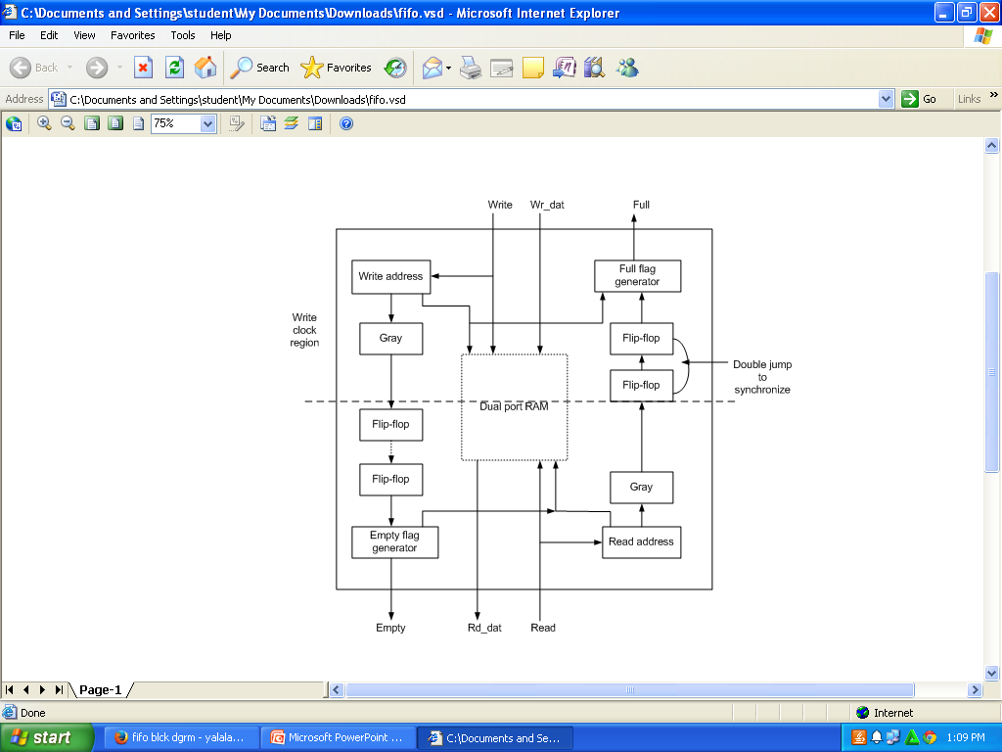
Block Diagram
fig: Asynchronous FIFO

Slide 5
Design of Asynchronous FIFO
Asynchronous FIFO includes the following modules:
- Dual-port RAM
- State logic module
- Gray code counter

Slide 6
Dual-port RAM
This is the heart of the FIFO whose width is 8 bits
It has two ports A and B which is fast and simple design.
It can configure port A as write port and port B as a read port.
It has an the following inputs :
Write Data
Write Enable and write clock
Read Enable and read clock
Write address
Read Address and
An output i.e. Read Data

Slide 7
Contd..
At the positive edge of the clock when the write enable is enabled, the data is written into the memory.
For reading the data, read enable should be enabled and the address from which the data has to be read should be specified at the input port read address.

Slide 8
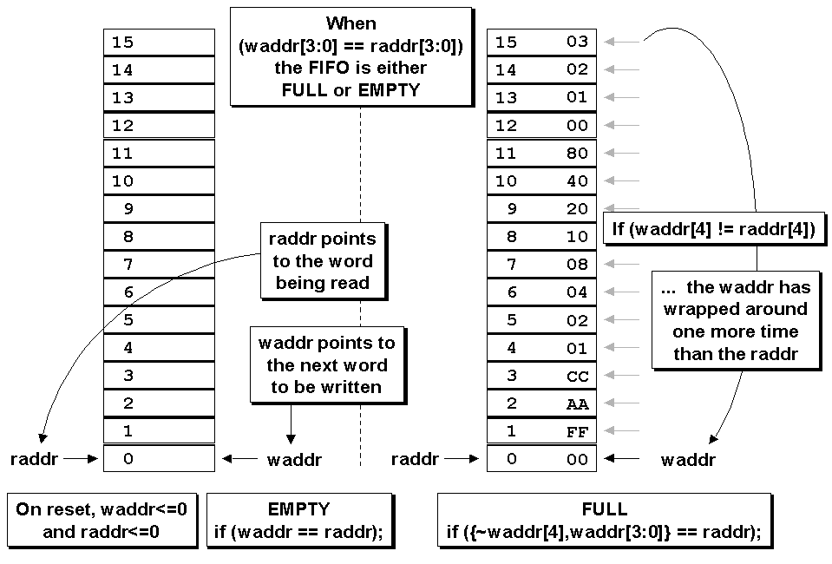
Contd..
Structure of FIFO

Slide 9
State logic module
State logic module provides FIFO empty and full flag signal.
Empty flag is generated in the read-clock domain to insure that the empty flag is detected immediately when the FIFO is empty.
Full flag will be generated in the write-clock domain to insure that the full flag is detected immediately when the FIFO is full.

Slide 10
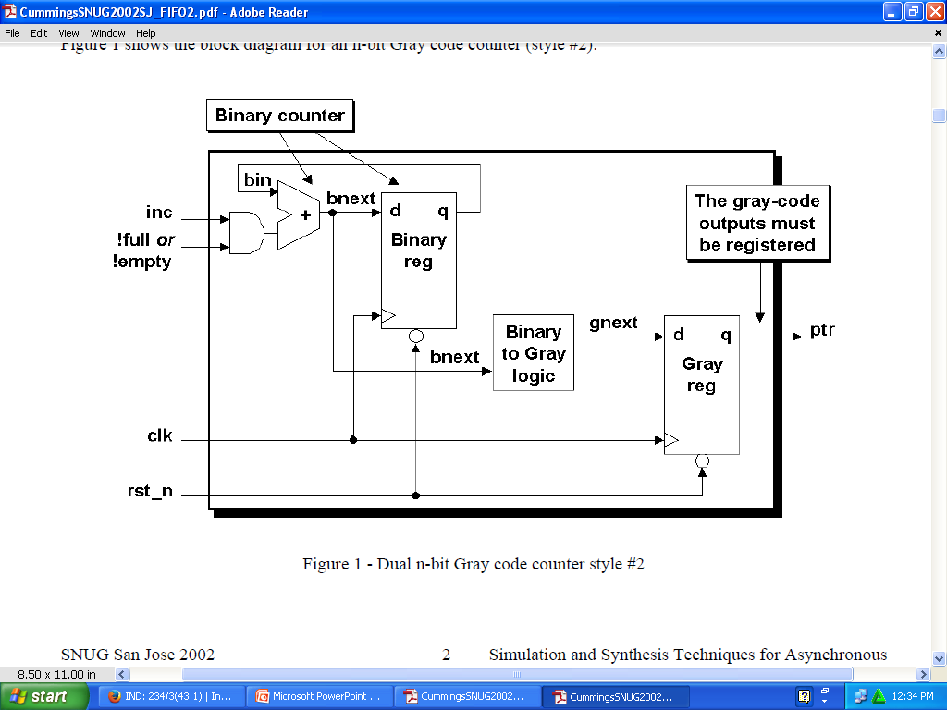
Gray code counter
Gray code counter uses two sets of registers, one a binary counter and second to capture a binary to-Gray converted value.

Slide 11
Contd..
The code distance between any two adjacent words is 1.
Gray code is used to eliminate fuzziness in the circuit.
It simplifies the error correction problem.
This implementation requires twice the number of flip-flops, but reduces the combinatorial logic and can operate at a higher frequency.

Slide 12
Contd..
In FPGA designs, availability of extra flip-flops is rarely a problem since FPGAs typically contain far more flip-flops than any design.
Reduces the amount of combinational logic and improves in speed.

Slide 13
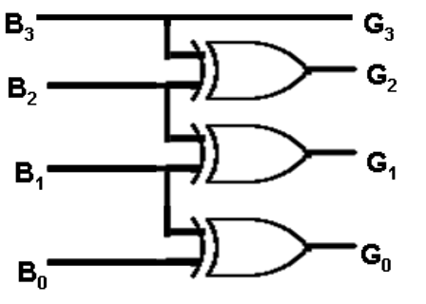

Contd..
b(1) b(2) b(3) b(4)
0 1 1 0
g(1) g(2) g(3) g(4)
0 1 0 1
Binary to Gray Conversion

Slide 14
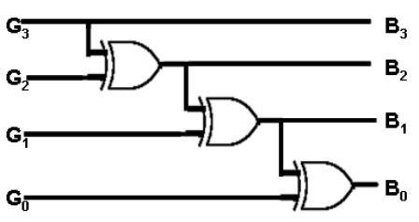
Contd..
g(1) g(2) g(3) g(4)
0 1 0 1
b(1) b(2) b(3) b(4)
0 1 1 0
Gray to Binary Conversion

Slide 15
FIFO depth calculation
D= [B-(clk_rd/clk_wr)*B*(1/RD)]
D = depth of number of locations in FIFO is stored
B = burst width
Clk_rd = read side clock frequency
Clk_wr = write side clock frequency
RD = read side delay in between reads

Slide 16
Conclusion
It is an efficient technique to implement a high-speed asynchronous FIFO, using dual-port RAMs addressed by Gray counters.
It has high reliability, re-configurability, low development cost and consumes low power.

Slide 17
References
Van de Goor, AI, Schanstra I. Zorian Y, Fault Models and Tests for Ring Address.
Nobutaro Shibata.maynmi watanabe. A current-sensed high speed and low-power first in first out memory using a wordline/bitline-swapped dual-port sram cell. IEEE Journal of Solid State Circuites. VOL 37, NO. 6, JUNE 2002.

Slide 18
THANK YOU

